Slide 1
A Simple Syntax-Directed Translator
Course Code: CSC3220
Course Title: Compiler Design
Dept. of Computer Science
Faculty of Science and Technology
Lecture No: | 4 | Week No: | 4 | Semester: | Fall 2023-2024
Lecturer: | Shahnaj Parvin, sparvin@aiub.edu

Slide 2
Lecture Outline
Quiz1
Learning Objectives
Context-free grammar​
Derivation
Ambiguity
Associativity of operators
Precedence of operators
Books and References

Slide 3
Objective and Outcome
Objective:
To explain the Context Free Grammar (CFG) with example.
To demonstrate derivation or derivation tree from a CFG
To elaborate ambiguity and ambiguous grammar.
To explain associativity and precedence of operator
Outcome:
After this lecture the student will able to demonstrate CFG
Student will be capable of derivation from CFG
Student will be able to differentiate if a grammar is ambiguous or not.
After this lecture student will learn associativity and precedence of operator

Slide 4
Context-free grammar
In this section, we introduce a notation — the "context-free grammar," or
"grammar" for short — that is used to specify the syntax of a language.
A grammar naturally describes the hierarchical structure of most programming language constructs.
For example, an if-else statement in Java can have the form
if ( expression ) statement else statement

Slide 5
Definition
A grammar consists of:
a set of variables (also called non terminals), one of which is designated the start variable; It is customary to use upper-case letters for variables;
a set of terminals (from the alphabet); and
a list of productions (also called rules).
A designation of one of the non terminals as the start symbol.

Slide 6
Formal Definition
One can provide a formal definition of a context free grammar. It is a 4-tuple (V, Σ, S, P) where:
• V is a finite set of variables;
• Σ is a finite alphabet of terminals;
• S is the start variable; and
• P is the finite set of productions. Each production has the form V → (V ∪ Σ)∗
Example: 0ⁿ1ⁿ Here is a grammar:
S → 0S1
S → ε
S is the only variable. The terminals are 0 and 1. There are two productions.

Slide 7
The grammar here defines simple arithmetic expressions. In this grammar,
the terminal symbols are id + - * / ( ) .
The nonterminal symbols are expression, term and factor,
and expression is the start symbol
expression → expression + term
expression → expression - term
Expression → term
Term → term *factor
term→ term / factor
term →factor
factor →(expression)
factor→ id

Slide 8
expression → expression + term
expression → expression - term
Expression → term
Term → term *factor
term→ term / factor
term →factor
factor →(expression)
factor→ id
Using these conventions, we can write down,
E→ E+ T | E- T | T
T →T* F | T / F | F
F→( E) | id
The notational conventions tell us that E T, and F are nonterminals, with E the start symbol. The remaining symbols are terminals

Slide 9
Derivation
A grammar derives strings by beginning with the start symbol and repeatedly replacing a nonterminal by the body of a production for that nonterminal.
The terminal strings that can be derived from the start symbol form the language defined by the grammar.

Slide 10
Derivation
S → 0S1
S → ε
The string 0011 is in the language generated.
The derivation is:
S =⇒ 0S1 =⇒ 00S11 =⇒ 0011
For compactness, we write
S → 0S1 | ε
where the vertical bar means or.
Consider the CFG
S → 0S1S | 1S0S | ε
The string 011100 is generated:
S =⇒ 0S1S =⇒ 01S =⇒ 011S0S =⇒ 0111S0S0S
=⇒ 01110S0S =⇒ 011100S =⇒ 011100

Slide 11
Derivation
This CFG generates sentences as composed of noun- and verb-phrases:
S → NP VP
NP → the N
VP → V NP
V → sings | eats
N → cat | song | canary
This generates “the canary sings the song”, but also “the song eats the cat”.
This CFG generates all “legal” sentences, not just meaningful ones.

Slide 12
For example, consider the following grammar, with a single nonterminal E which adds a production :
E→ E +E | E *E | -E |( E )| id
2 types derivation can happen : Left Most & Right Most Derivation
Example : (Left Most)
Input: -(id+id)
E → -E →-( E ) →-(E+ E ) →- ( id +E ) →- (id + id )
TRY RIGHT MOST!!

Slide 13
Parse Trees and Ambiguity
A parse tree pictorially shows how the start symbol of a grammar derives a
string in the language. If nonterminal A has a production A -> XYZ, then a
parse tree may have an interior node labeled A with three children labeled X,
Y, and Z, from left to right.
A grammar can have more than one parse tree generating a given string of terminals. Such a grammar is said to be ambiguous.

Slide 14
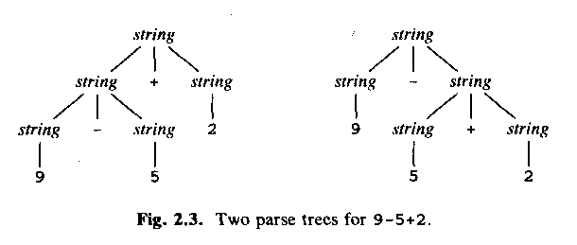
Derivation
string ->string + string | string - string | 0 | 1 | 2 | 3 | 4 | 5 | 6 | 7 | 8 | 9

Slide 15
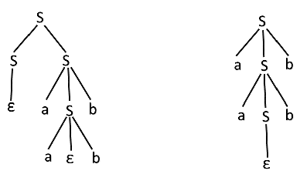
Check if the given grammar G is ambiguous or not.
S → aSb | SS
S → ε
For the string "aabb" the above grammar can generate two parse trees
Since there are two parse trees for a single string "aabb", the grammar G is ambiguous.

Slide 16
Exercises
1. Consider the context-free grammar:
S-> S S + |S S * |a
and the string aa + a*.
a) Give a leftmost derivation for the string.
b) Give a rightmost derivation for the string.
c) Give a parse tree for the string.
d) Is the grammar ambiguous or unambiguous? Justify your answer.
2. Determine the following grammar is ambiguous or not. Show ambiguity using parse tree if any of the grammar is ambiguous.
S → S a A | A
A → A b B | B
B → c S d | e

Slide 17
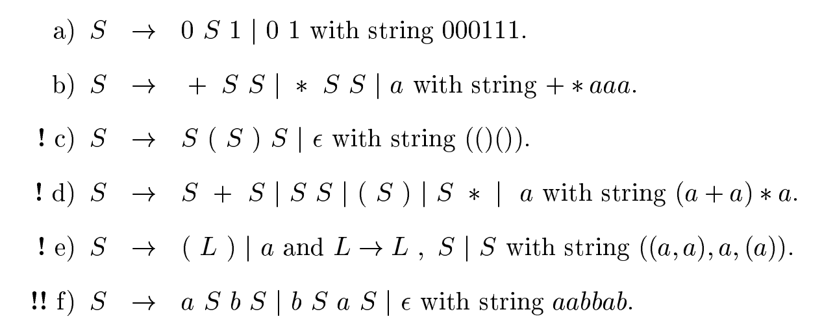
Exercises

Slide 18
Associativity of operators​
left-associative
By convention, 9+5+2 is equivalent to (9+5)+2 and 9 - 5 - 2 is equivalent to ( 9 - 5 ) - 2 .
When an operand like 5 has operators to its left and right, conventions are needed for deciding which operator applies to that operand.
We say that the operator + associates to the left, because an operand with plus signs on both sides of it belongs to the operator to its left. In most programming languages the four arithmetic operators, addition, subtraction, multiplication, and division are left-associative.

Slide 19
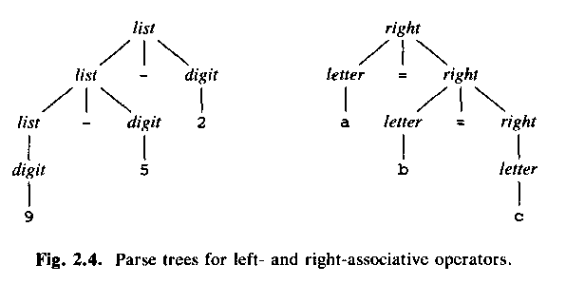
Right-associative
Some common operators such as exponentiation are right-associative.
As another example, the assignment operator = in C and its descendants is right associative; that is, the expression a=b=c is treated in the same way as the expression a=(b=c).
Strings like a=b=c with a right-associative operator are generated by the following grammar:
list→ list -digit|letter|digit
digit→ 0|1|2|……9|0
right ->• letter = right | letter
letter -> a | b | • • • | z

Slide 20
Precedence of operators
Consider the expression 9+5*2.
There are two possible interpretations of this expression: (9+5)*2 or 9+(5*2).
The associativity rules for + and * apply to occurrences of the same operator, so they do not resolve this ambiguity.
We say that * has higher precedence than + if * takes its operands before + does.
In ordinary arithmetic, multiplication and division have higher precedence than addition and subtraction. Therefore, 5 is taken by * in 9+5*2.

Slide 21
Lecture References
1. Compilers-Principles, techniques and tools (2nd Edition) V. Aho, Sethi and D. Ullman

Slide 22
References/ Books
1. Compilers-Principles, techniques and tools (2nd Edition) V. Aho, Sethi and D. Ullman
2. Principles of Compiler Design (2nd Revised Edition 2009) A. A. Puntambekar
3. Basics of Compiler Design Torben Mogensen

